Slide 1
wueHans: A Full-Stack Open-Source RISC-V Gaming Console and SoC Architecture
Yannik Stamm, Jonathan Hager, Timo Grundheber, Matthias Jung and Sebastian von Mammen
11.06.2026
Notes:
Slide danach mit Spielekonsole, die schon existiert und dazu die einleitenden Worte

Slide 2
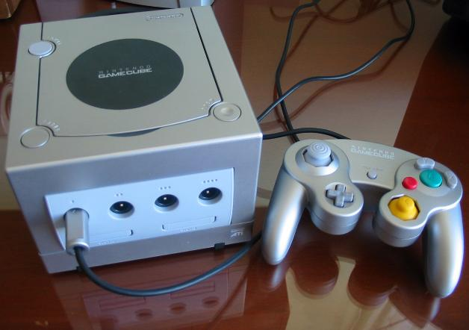
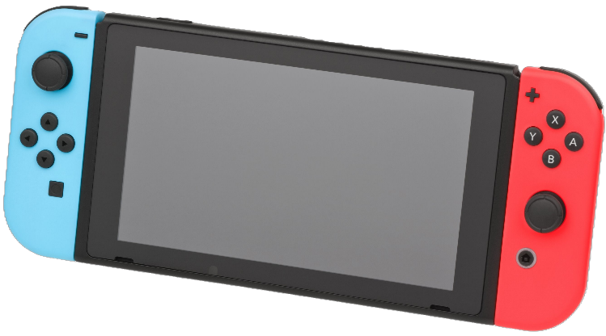
Different consoles
We've built our own!
[7]
[8]

Slide 3
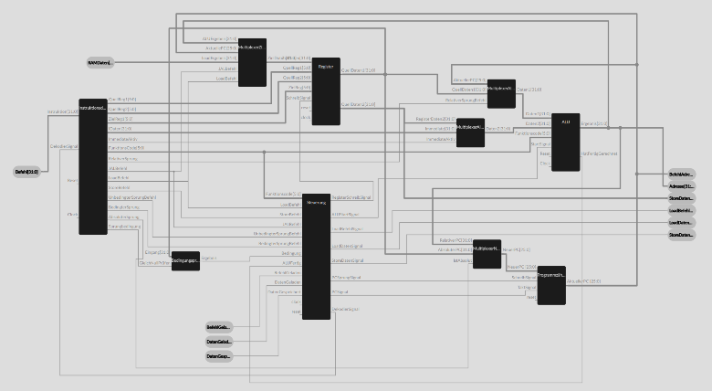
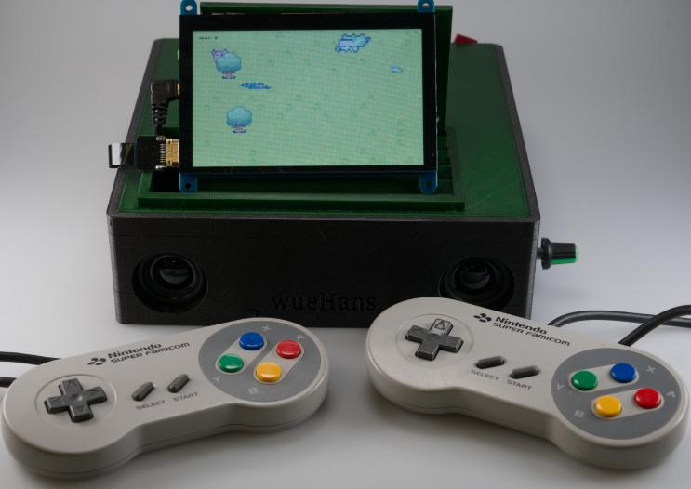
Progress of our console
2023
2025
  Selfmade CPU with custom ISA
  FPGA-based
  Adapted vasm backend [6]
  Custom linker and loader
  Move to open source RISC-V core
  FPGA-based
  Custom GPU
  3D-printed case

Slide 4
Console Architecture
  50 MHz VexRiscv
  4 kB I- and D-cache
  400x240 sprite-based GPU
  32 kHz, 16-bit audio
  32 kB SRAM
  32 MB SDRAM
  Game input with two SNES controllers
  ELF format supported by the bootloader

Slide 5
RISC-V CPU
  VexRiscv (CPU) [5]
    many alternatives, e.g., Neorv, picorv, ...
  ISA extensions:
    Rv32imf
    Hardware floating-point support
  Open-Source design
  Memory-mapped registers for
    GPU
    Audio
    ...
Address | Name
0x00000000 | SDRAM
0x02000000 | GPU
0x02000100 | Audio
0x02000200 | Controller
0x02000300 | Counter
0x02002000 | Color table
0x02010000 | Bootloader
0x80000000 | SD-Card

Slide 6
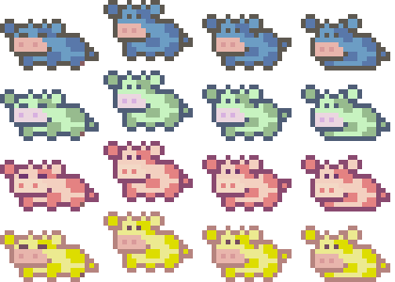
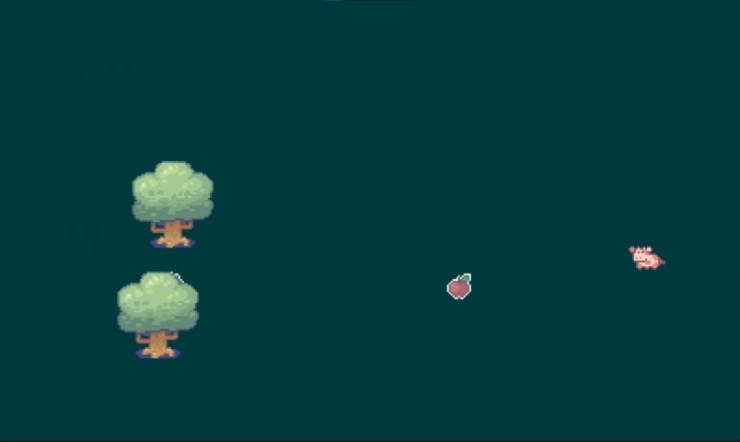
Sprite-Based GPU
imageStart
imageWidth
(xOffset, yOffset)
(screenX, screenY)
height
width
Notes:
+ Tabelle ausm Wiki. Gibt Daten, Befehle, ...

Slide 7
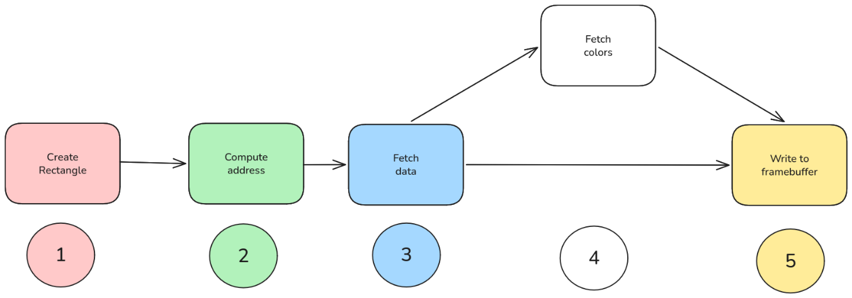
Sprite-Based GPU
Rectangle is created
Address of the desired pixels is computed
Data is fetched from the AXI Bus
Images only store indices to a color table. The correct colors are fetched
The final pixels are written to the framebuffer
Notes:
1-5 animieren

Slide 8
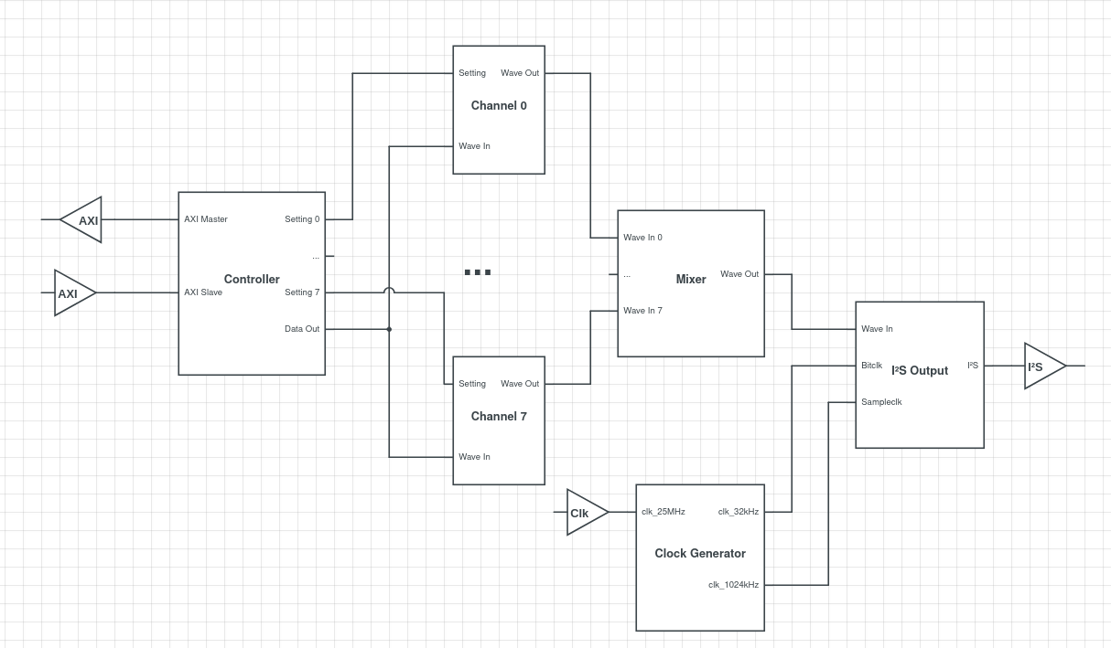
Audio System

Slide 9
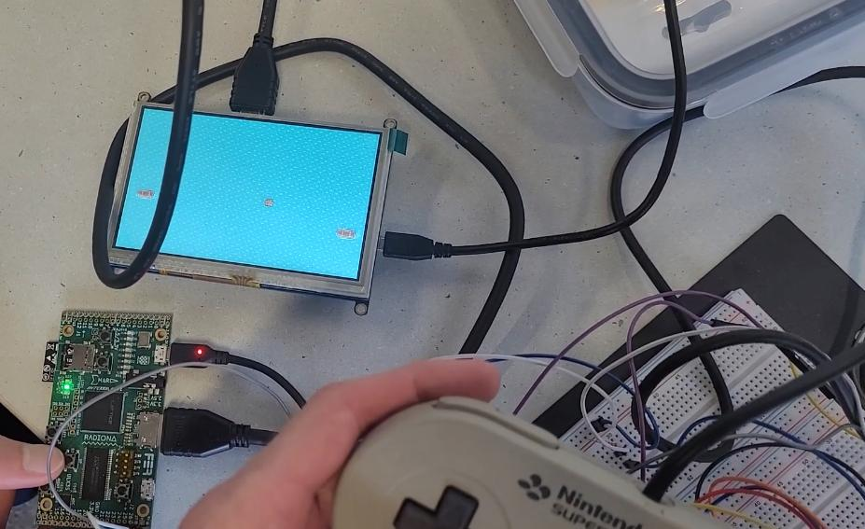
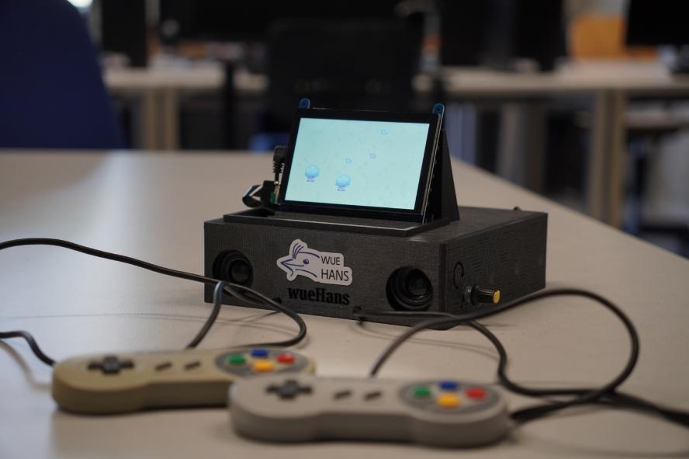
Prototype

Slide 10
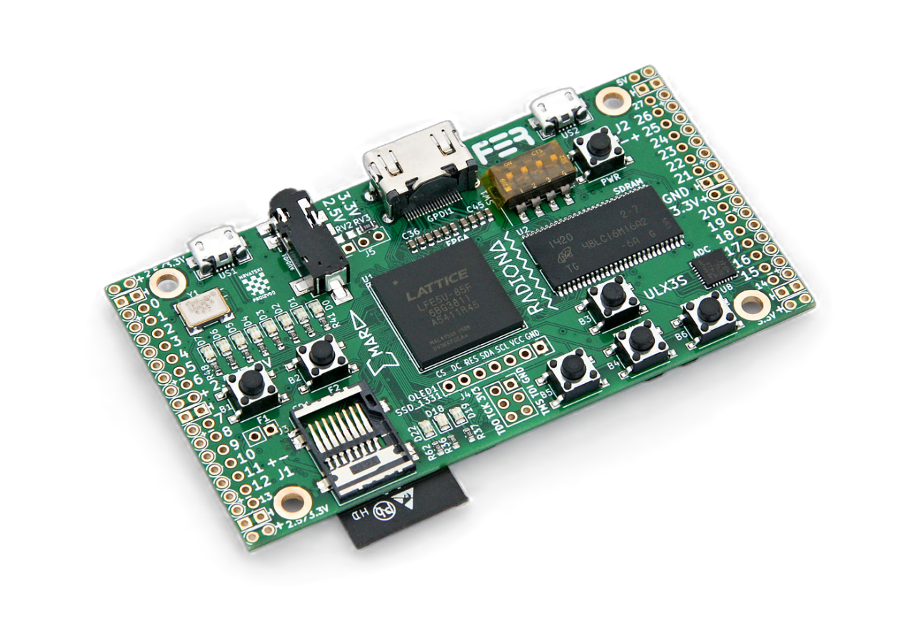
Prototype
  Lattice ECP5 with 84k LUT
  32 MB SDRAM
  Micro-SD slot (to store the game)
  Digital video output
  25 MHz clock
[1]
Notes:
Daten zum FPGA

Slide 11
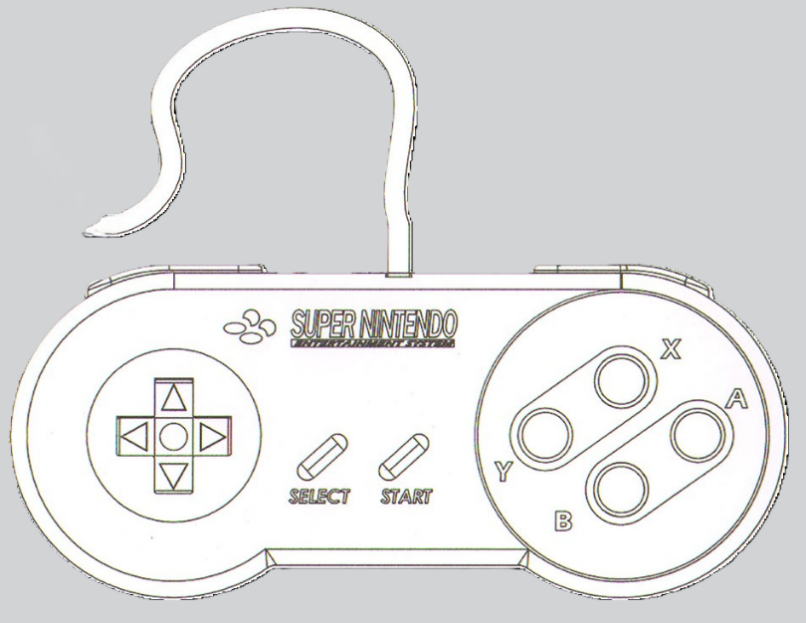

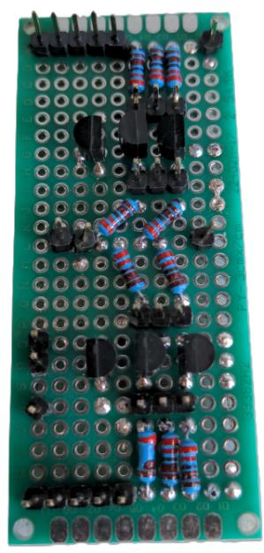
Prototype - Controller
Level shifter
[1]
[2]
3.3 V
5 V
Notes:
Boxen über die Bilder

Slide 12
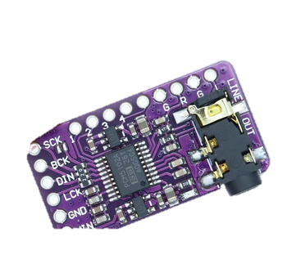
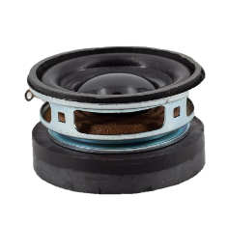
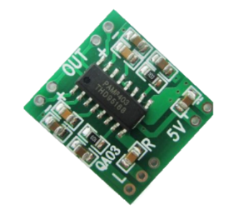
Prototype - Audio
Digital-Analog converter
Amplifier
Speakers
Notes:
Boxen mit Aufgabe der Platinen

Slide 13
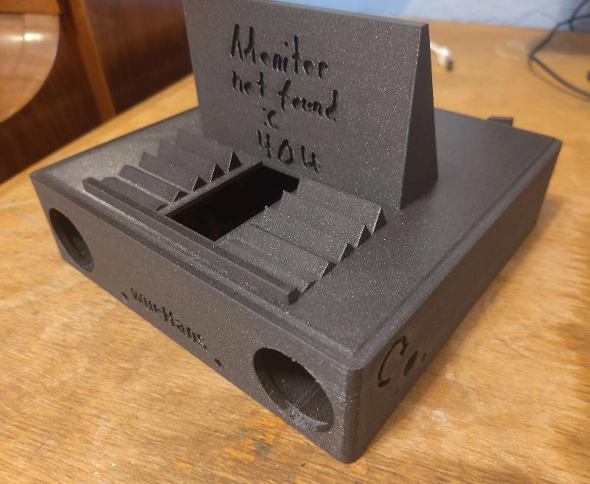
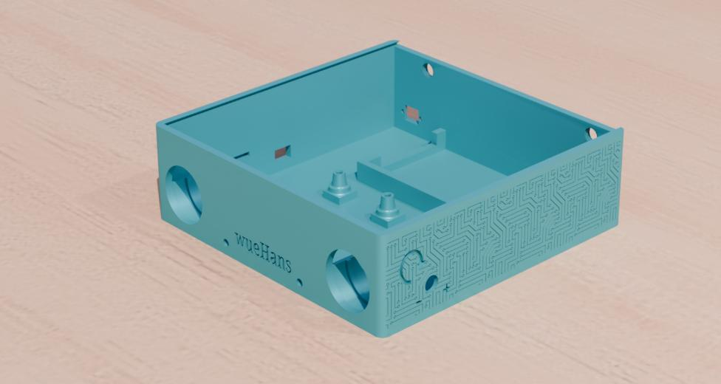
Prototype - Case

Slide 14
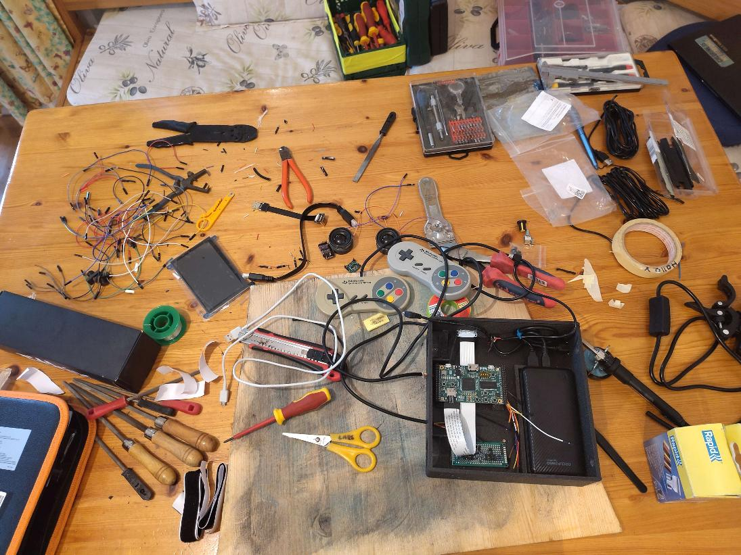
Prototype - "Workstation"

Slide 15
Prototype

Slide 16

EDA Tools & Software
EDA Tools:
  Simulation: Icarus Verilog, GTKwave and Surfer
  Synthesis: Yosys, nextpnr, fujprog
  All tools bundled in the oss-cad-suite [3]
  Build system with CMake for hardware and software
Software:
  Support for C and C++ with the newlib [4] standard library
  Virtual prototype for testing and debugging
  Hardware Abstraction Library
  Software template that can be used to quickly start developing
  Bootloader
Notes:
Screenshot von einem Tool

Slide 17
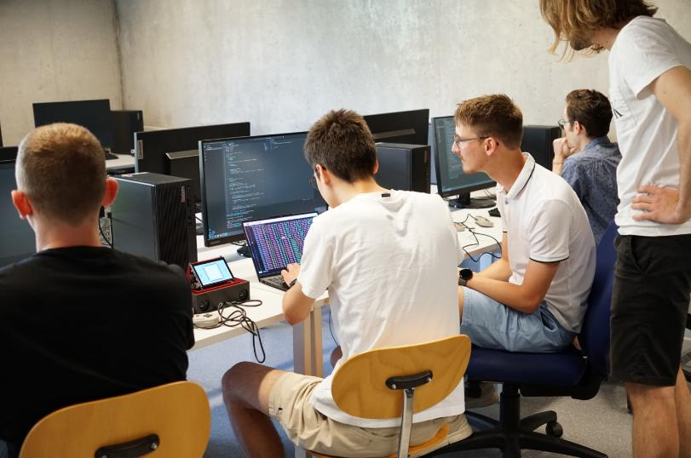
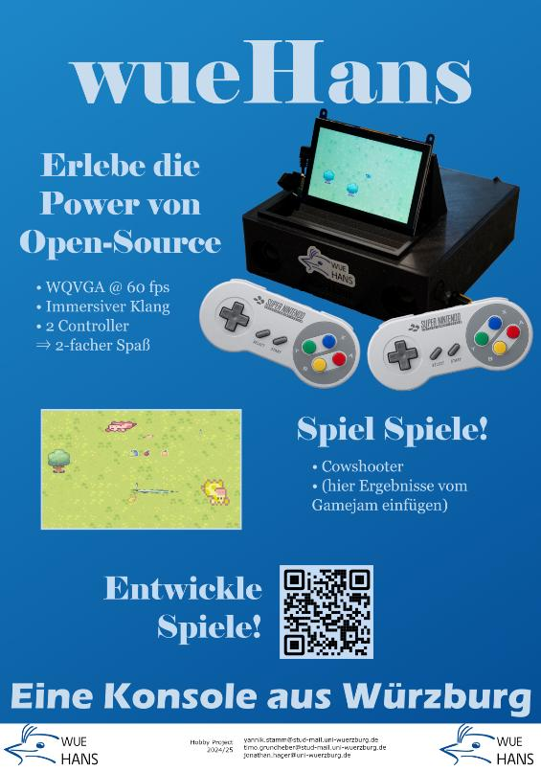

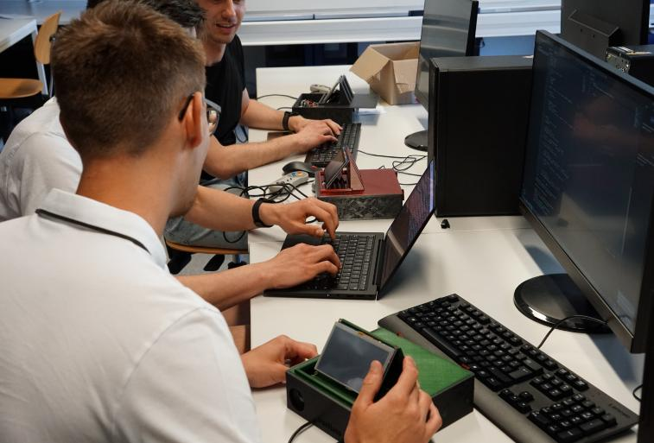
Game Jam
  One weekend spent at the university
  High interest especially of Games-Engineering students
  Low barrier of entry for any game developer

Slide 18
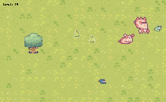
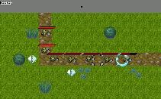

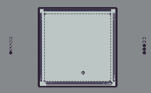
Current Games
Cow Shooter
Hans Tower Defense
Hans The Gatherer
Hans Tennis

Slide 19
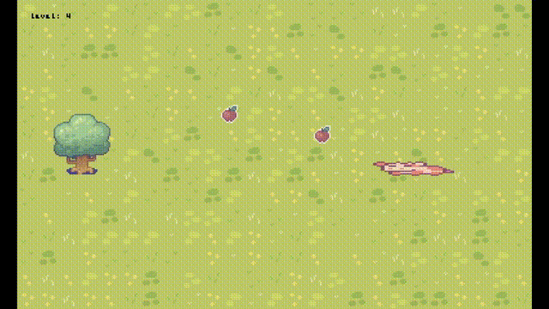
Current Games
Cow Shooter
Hans Tower Defense
Hans The Gatherer
Hans Tennis

Slide 20
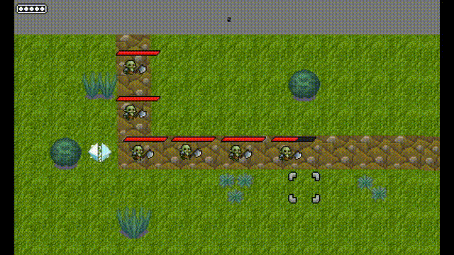
Current Games
Cow Shooter
Hans Tower Defense
Hans The Gatherer
Hans Tennis

Slide 21
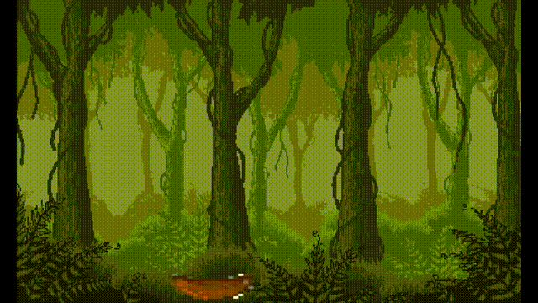
Current Games
Cow Shooter
Hans Tower Defense
Hans The Gatherer
Hans Tennis

Slide 22
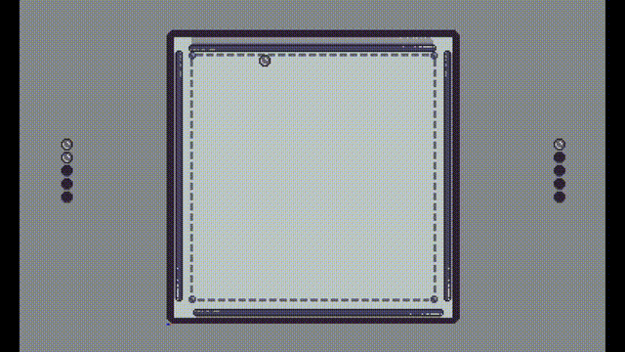
Current Games
Cow Shooter
Hans Tower Defense
Hans The Gatherer
Hans Tennis

Slide 23
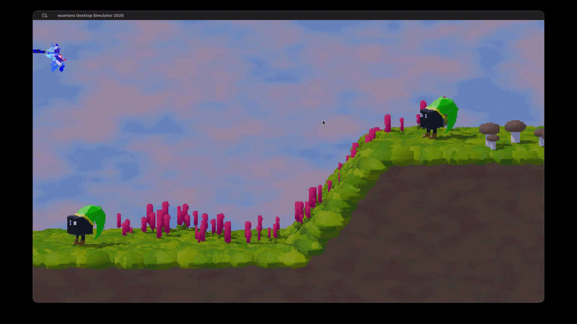
Next Steps
  Improve the audio
  Multicore RISC-V core
  Extend our GPU to handle 3D
  2nd Game Jam
  Integrate everything on a single PCB
  Tapeout with the IHP Open-Source PDK

Slide 24
References
ULX3S. (2026, May 27). Retrieved from https://radiona.org/ulx3s
Behance. (2019). SolidWorks | SNES Controller - Aonghus Quinn. Behance. Retrieved from https://www.behance.net/gallery/74554165/SolidWorks-SNES-Controller?locale=de_DE
oss-cad-suite. https://github.com/YosysHQ/oss-cad-suite-build
Newlib. https://sourceware.org/newlib/
VexRiscv. https://github.com/SpinalHDL/VexRiscv
vasm. http://sun.hasenbraten.de/vasm/
Martin Iturbide. https://commons.wikimedia.org/wiki/File:Nintendo_Gamecube_Silver.JPG (GNU FDL, unmodified)
Evan-Amos. https://commons.wikimedia.org/wiki/File:Nintendo-Switch-wJoyCons-BlRd-Standing-FL.png

